Slide 1
Vehicles license plates detection
Raul-Mihai Acu
Zsolt Kovacs

Slide 2
Introduction
License plate recognition is one of the most important requirements of intelligent transportation system, providing services such as security control over restricted areas, traffic monitoring, surveillance systems, or parking management systems.
Various features of a license plate including aspect ratio, shape, color, text features, edge density can be used to locate areas where the plates are found.
However, a good recognition system has to be efficient under various circumstances such as low contrast, dirty plates, different weather conditions, illumination changes and other environmental characteristics.

Slide 3
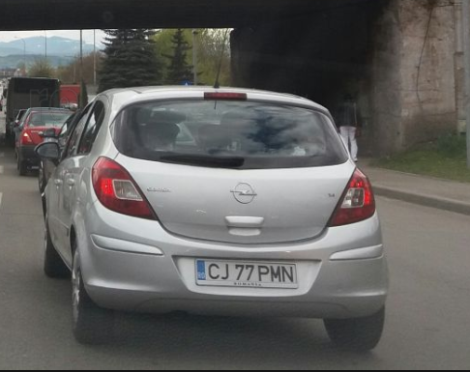
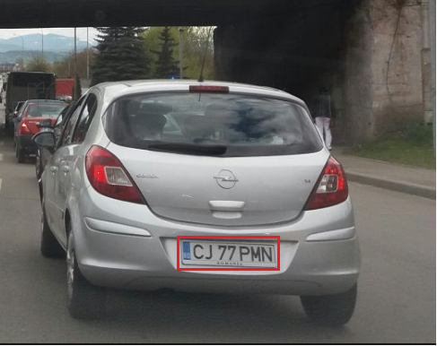
Project description
Color images of vehicles at different distances with visible license plates are given (the license plates can be a little bit rotated to the horizontal direction);
An algorithm to identify and mark the areas where the license plates are found will be implemented.

Slide 4
Algorithm overview
One of the characteristic properties of a license plate is the strong edges associated with dark characters on a bright background and a mainly rectangular shape. This attribute can be very useful for finding the location of a plate in images.
As mentioned before, the system of license plate recognition faces many challenges due to environmental conditions or poor image quality. To overcome these losses, a pre-processing of the image might be required in order to enhance it and make it more suitable for the upcoming processing steps.
This can be obtained by increasing saturation and contrast, to make colors more distinguishable and to separate the background from the highlights.

Slide 5
Algorithm overview
After the pre-processing stage, the image is now suitable for the identification of license plates location, in order to output sub-images or mark accordingly their position.
The flow of the processing stage is presented below:
Shape recognition
Iterate through image pixels, finding rectangle shaped objects.
Properties verification
Check the found shape for the above mentioned license characteristics.
Location marking
If all the requirements are met, mark the license plate location.

Slide 6
Algorithm overview
Pre-processing
The first step refers to processing and preparation of an image which is necessary for further license plate detection and character recognition. Pre-processing involves the application of digital filters to an image. This will be achieved by performing a series of morphological operations:
Conversion into Grayscale
Thresholding & Additional thresholding if needed – transforming the image into a binary one without losing relevant information
Erosion, Dilation → Opening & Closing – in order to remove the noise and close the small holes inside the foreground objects, or small black points on the object.
Top Hat , Black hat – background equalization, image enhancement, preparing the image for character recognition and edge detection

Slide 7
Algorithm overview
Shape Recognition
The next step towards our goal requires a series of methods for recognizing rectangular shapes in the image. In order to do that, we have the following options:
Drawing contours – can be explained simply as a curve joining all the continuous points along the boundary, having same color or intensity. Finding contours is like finding white object from black background.
Canny Edge detection – used to detect the edges in an image. It accepts a gray scale image as input and it uses a multistage algorithm. It also involves some morphological operations which furthermore reduces the difficulty of recognizing plates.
After obtaining the strong edges and contour of objects in the image, it is possible now to recognize rectangular shapes by performing:
Aspect Ratio checks – the proportional relationship between shape`s width and height.

Slide 8
Algorithm overview
Properties verification
After finding potential license plates locations, we need to ensure that they are not regular postcards or random objects from the environment, by considering some of the before mentioned properties. This might involve:
Segmentation – dividing the license plate area into smaller parts in order to search for characters. As we know, a Romanian license plate has somewhere around 5-8 characters
Recognition – the set of possible outputs are characters that appear on license plates, which are letters of the alphabet or numbers from 0 to 9. These characters might be harder to identify, having different characteristics such as: white foreground on a black background, smaller size, so we might consider splitting the search for these characters and the recognition of basic characters.
After performing this step, we can proceed to the final stage of the algorithm.
Location marking
If all the requirements are met, and the preceding steps occurred as expected, we can now mark the obtained location by simply drawing a different-color rectangle, around the boundaries of the plate

Slide 9
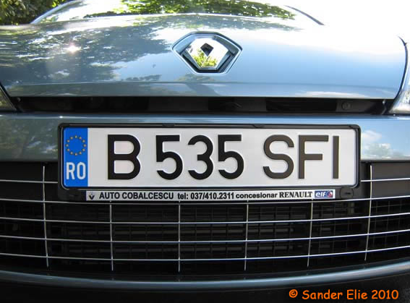
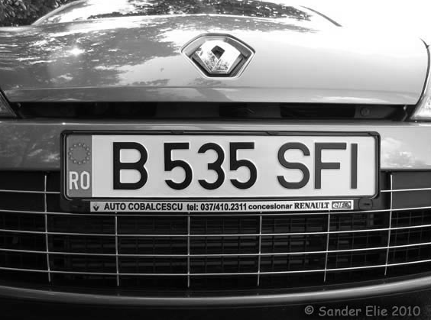
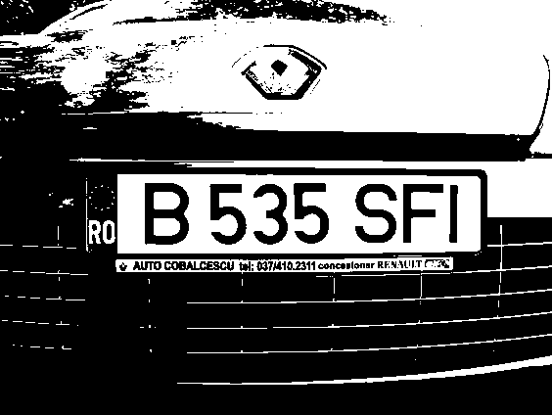
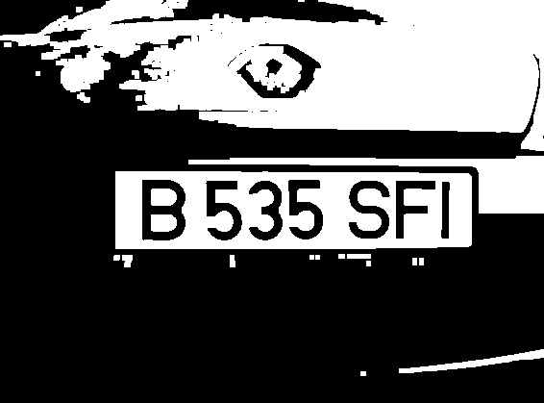
Algorithm implementation
Pre-processing stage
Provided an input image, we will apply some filters and morphological operations in order to prepare the image for shape detection, removing noise and straightening the identification process.
Source image
Grayscale
Threshold
Opening

Slide 10
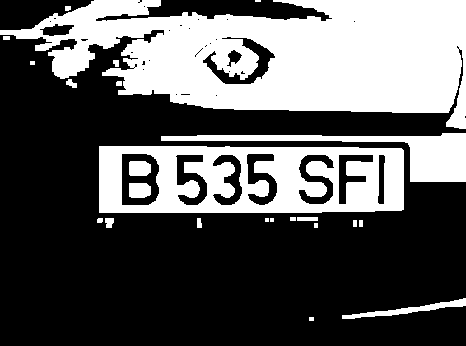

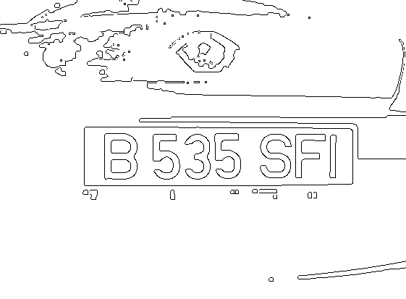

Algorithm implementation
Shape detection phase
After the pre-processing stage, we can now identify the set of possible license plates. Using a labeling algorithm, we separate each found object and apply a shape detection algorithm, check their aspect ratio and number of contained objects.
Pre-processed image
Labeling algorithm
Contours
Detected shape

Slide 11
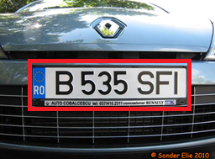
Algorithm result
Location marking
After detecting the shape and it`s position, we can now mark it on the image using a bounding box contour drawing.
Input image
Pre-processed image
Shape detection
Resulted image

Slide 12
Bibliography
Open Computer Vision source
https://docs.opencv.org/3.3.0/index.html
Related papers
http://inf.ucv.ro/~ami/index.php/ami/article/viewFile/388/351
https://stackoverflow.com/questions/4707607/what-are-good-algorithms-for-vehicle-license-plate-detection
https://stackoverflow.com/questions/981378/how-to-recognize-vehicle-license-number-plate-anpr-from-an-image/37523538#37523538
http://www.eurasip.org/Proceedings/Eusipco/Eusipco2007/Papers/d3l-b05.pdf

